Slide 1
Multilanguage on-line handwriting recognition
Haoran Zhang

Slide 2
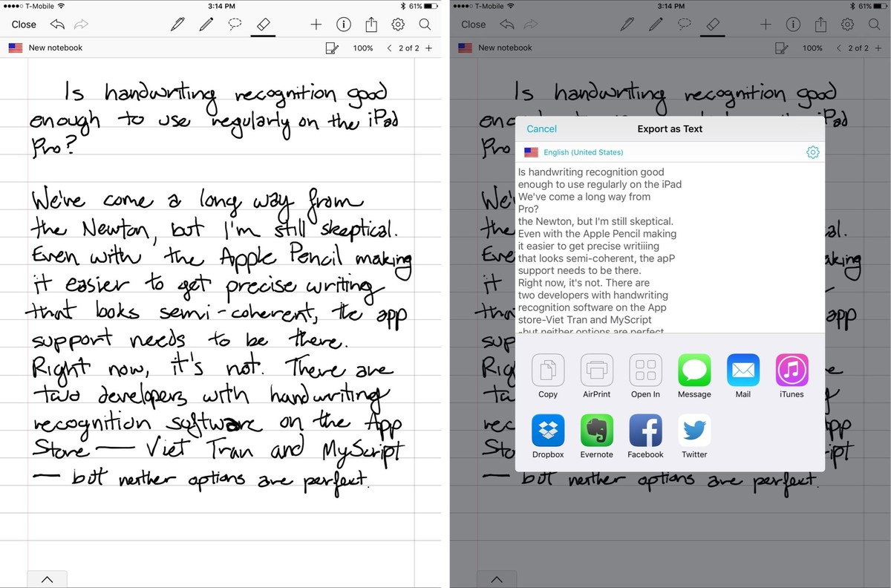
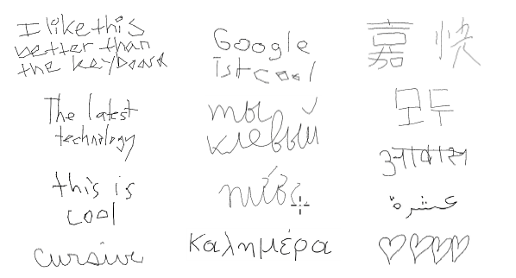
What is handwriting recognition
Handwriting recognition is the ability of a computer to receive and interpret intelligible handwritten input from sources such as paper documents, photographs, touch screens and other devices (Wikipedia)

Slide 3
On-line？
On-line recognition refers to methods and techniques dealing with the automatic processing of a message as it is written using a digitizer or an instrumental stylus that captures information about the pentip, position, velocity and acceleration as a function of time

Slide 4
Off-Line？
Off-line recognition is just to recognize characters and words that is already written

Slide 5
Challenges for on-line handwriting recognition
1. Strong variability in writing style
2. Ambiguity
3. Difficult to recognize thousands of characters
4. Handwriting recognize may be inaccurate because of the delayed input

Slide 6
Steps to handwriting recognition
1. preprocessing
2. segmentation and search lattice creation
3. generation and scoring of character hypotheses
4. best path search in the resulting lattice

Slide 7
Preprocessing
1. resampling：length resampling
2. slop correction: adjust non horizontal and vertical strokes
rotate and choose best score
Advantages: efficient, flexible

Slide 8
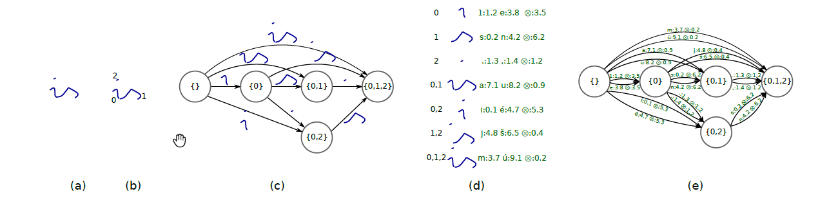
Search lattice creation
1. create segmentation lattice: cut points and scores
2. extract features
3. label the lattice: state machine

Slide 9
Search for result
1. ink-aligned beam search: consider all edges & calculate score on each
node
2. search preceding text
3. pruning: reduce size of decision trees

Slide 10
Training
Training models
Training segmenter
Training feature wights
Training data

Slide 11
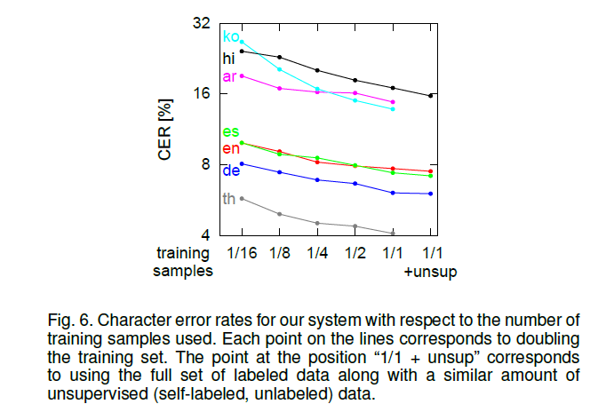
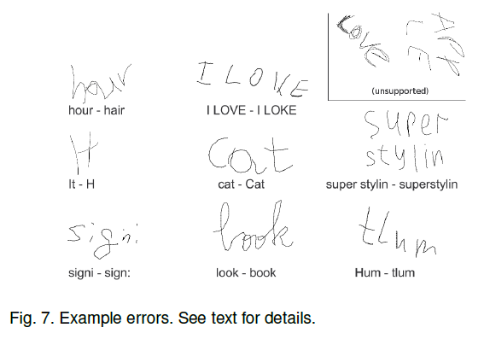
Works better!

Slide 12
Why better？
Time and position based: handles overlapping and delay
Use MERT, a method for learning feature weights for machine translation
Better pruning approaches: works better on less powerful device

Slide 13
Add more features
Different segmentation and decoding algorithms
Machine learning

Slide 14
Work citation
https://en.wikipedia.org/wiki/Handwriting_recognition
http://www.imore.com/i-want-handwriting-recognition-iphone-and-ipad-even-if-it-stinks
http://ieeexplore.ieee.org/stamp/stamp.jsp?tp=&arnumber=7478642&tag=1

